Slide 1



Holy Cross English School
Nirmal, Vasai(W).
WELCOMES ALL

Slide 2


Slide 3


Slide 4

A warm Welcome to All from…
Rev. Fr. Alex Gonsalves
Manager, Holy Cross English School
Rev. Fr. Brendan Furtado
Principal, Holy Cross English School

Slide 5
We also Welcome our Guests...
Chief Guest :
Ms. Hema Bhanga
International & National Athletic player
Guest of Honour:
Fr. Wilson Rebello
Director of Diocesan Board of Education

Slide 6

Glimpses of Activities in our School
Throughout the year…

Slide 7

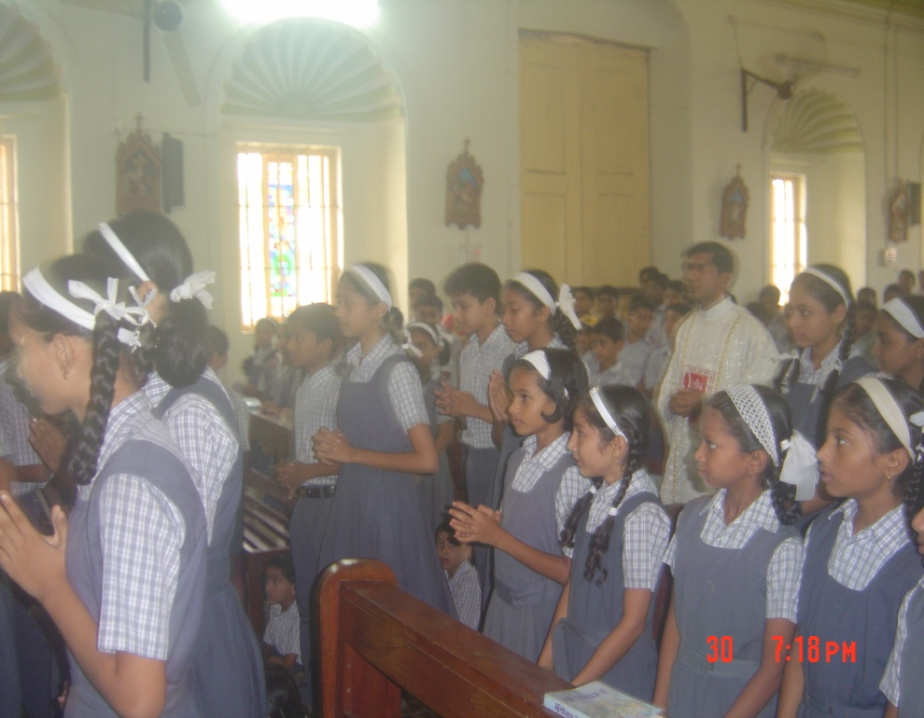
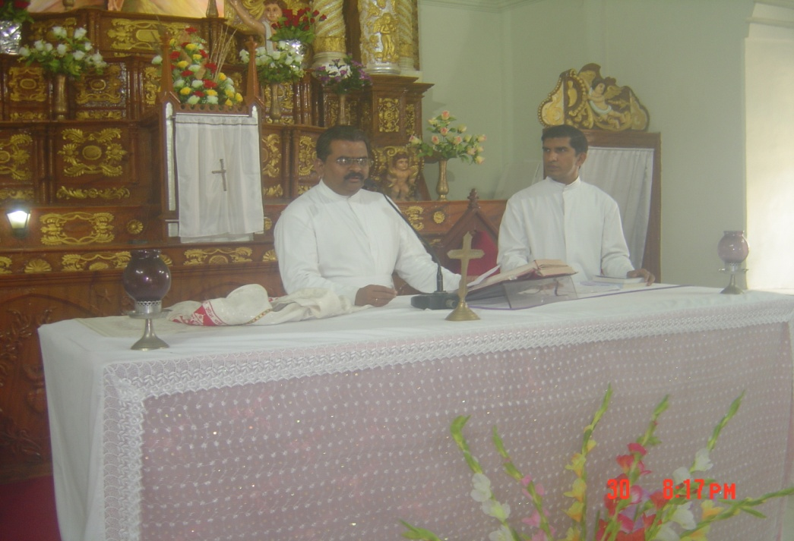
Eucharistic Celebration

Slide 8


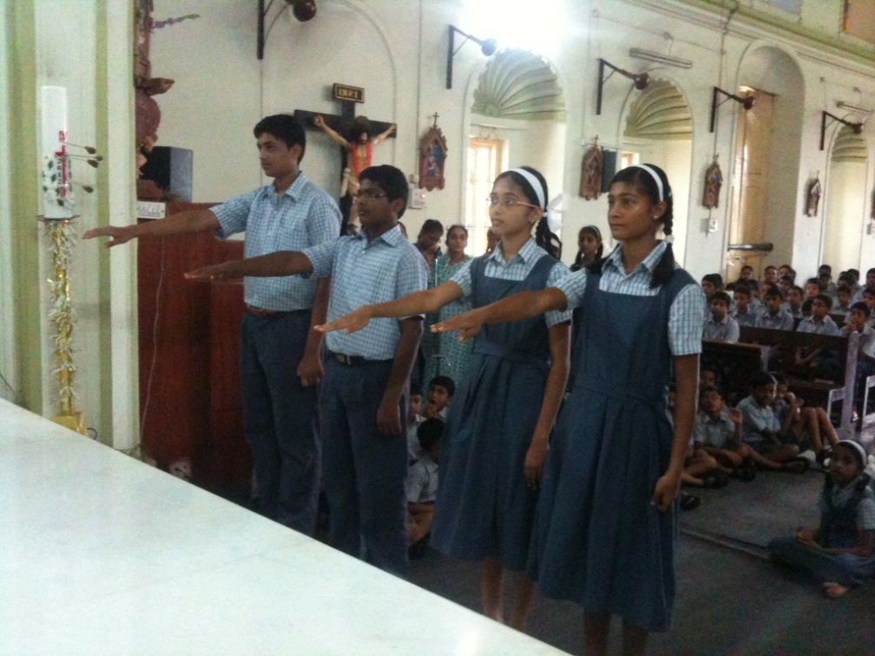
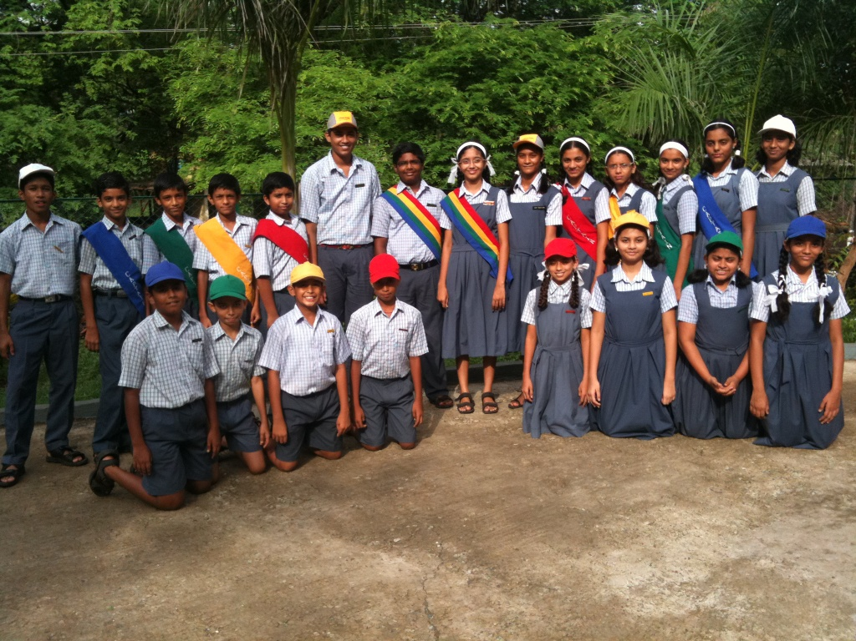
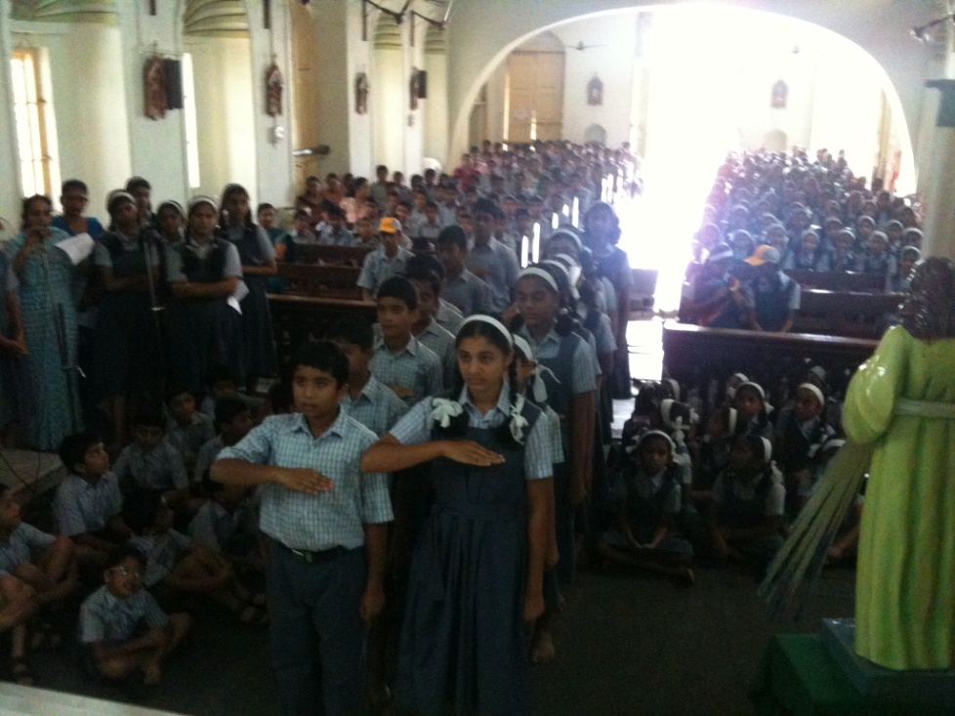
Oath Taking
Ceremony

Slide 9

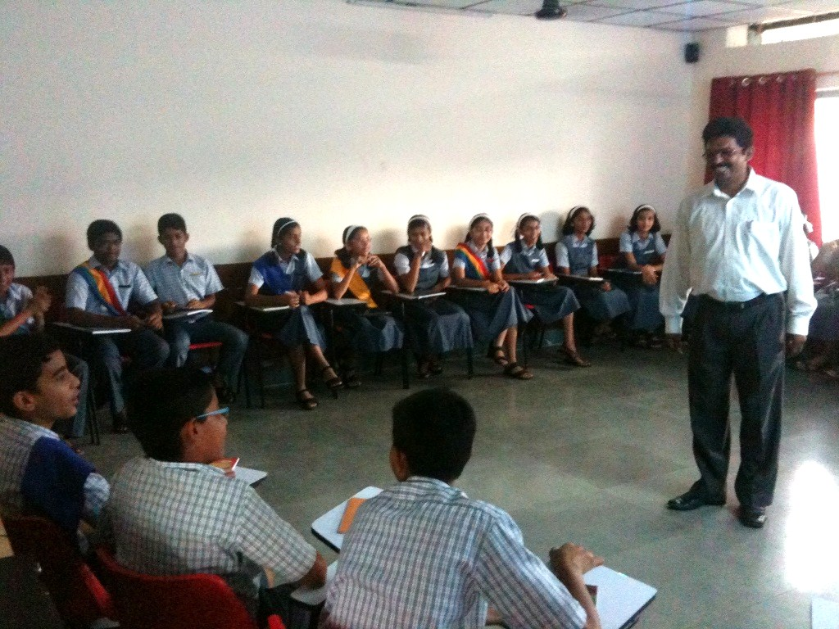
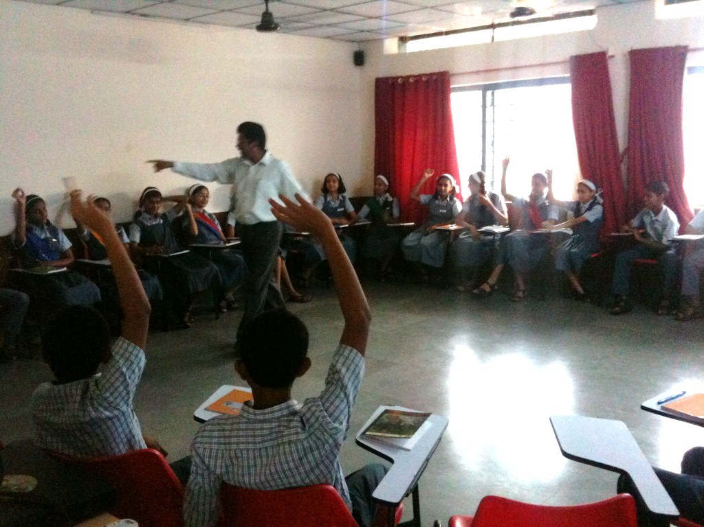
Orientation for
Captains

Slide 10

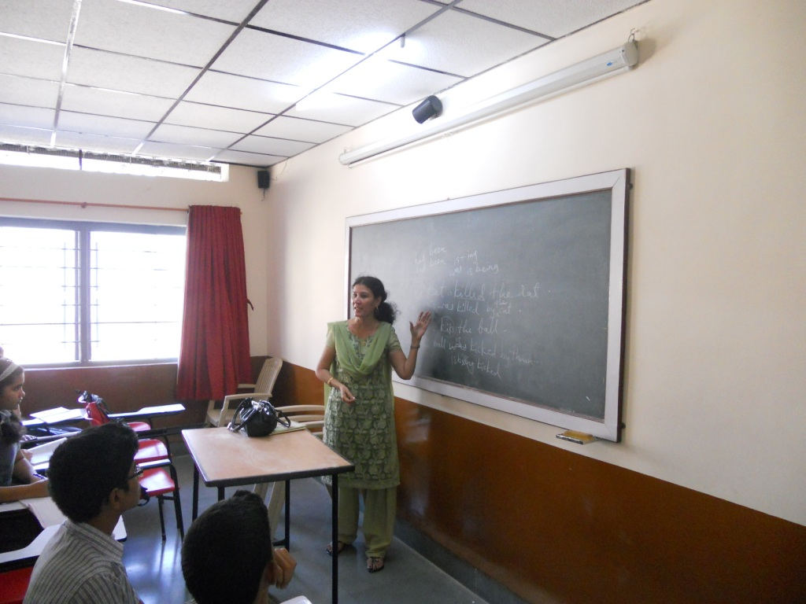
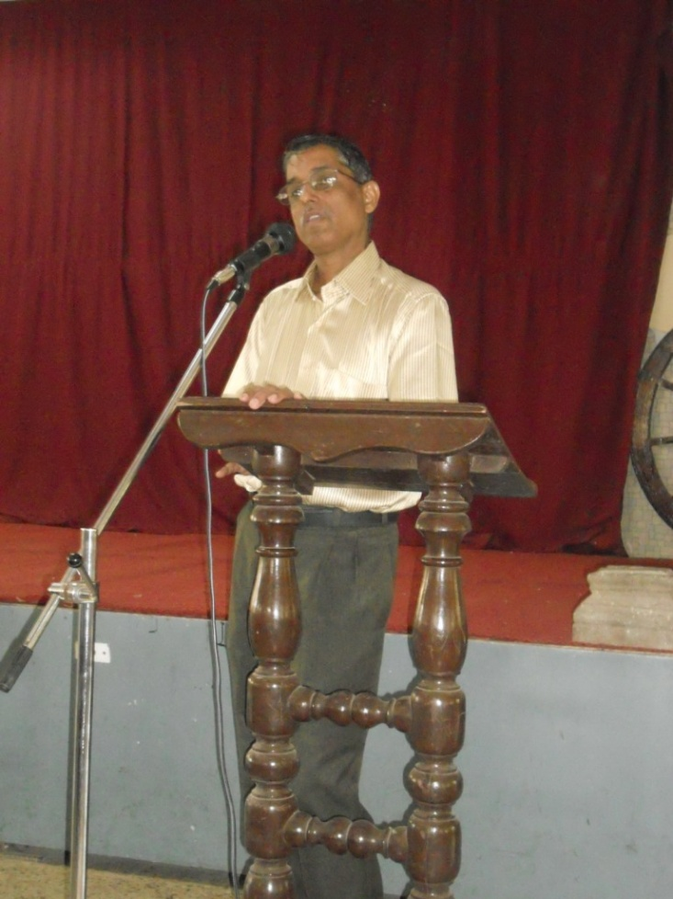
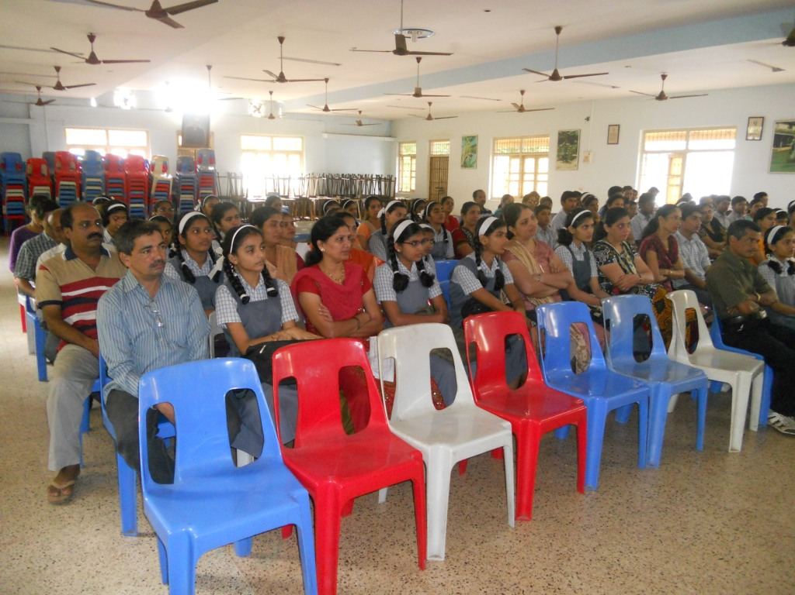
Resource persons for
SSC Students

Slide 11

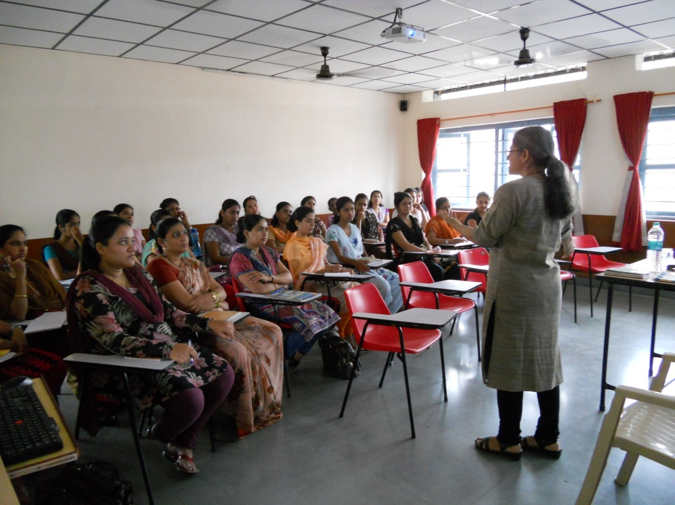
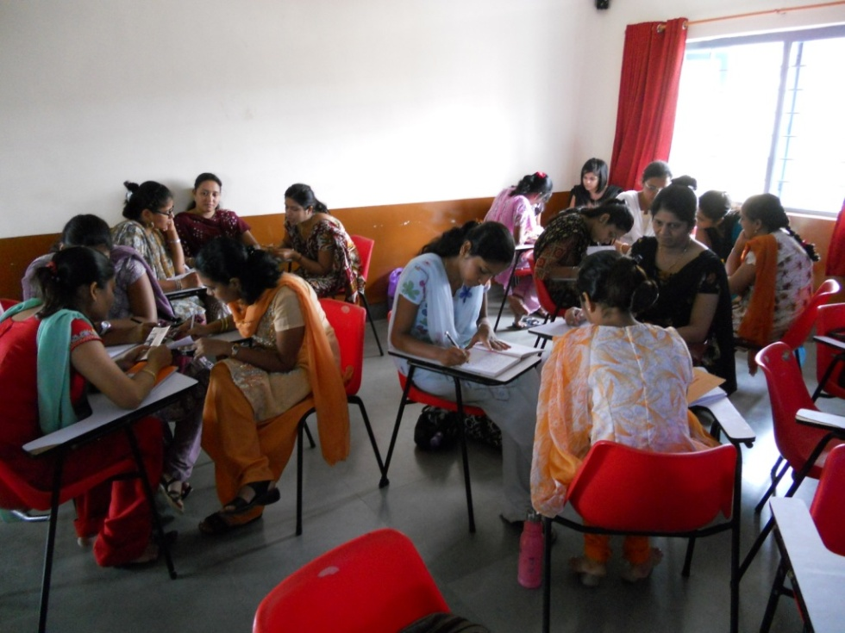
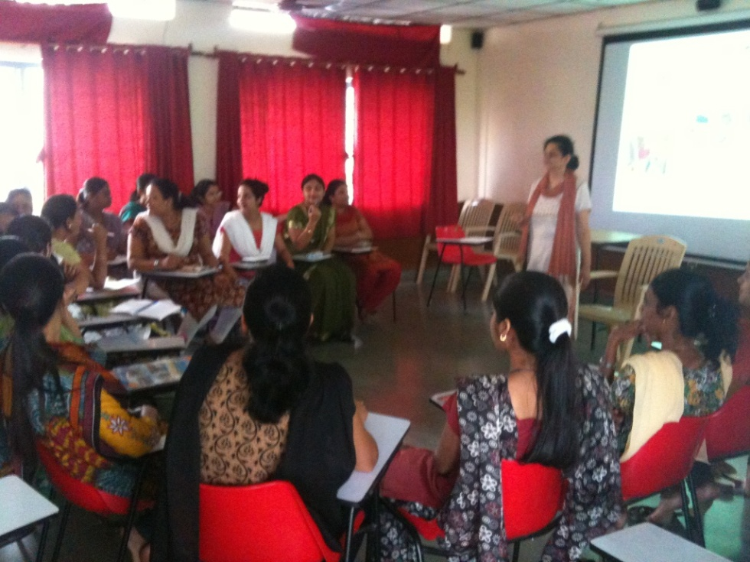
Prafulta
Session for
Teachers

Slide 12

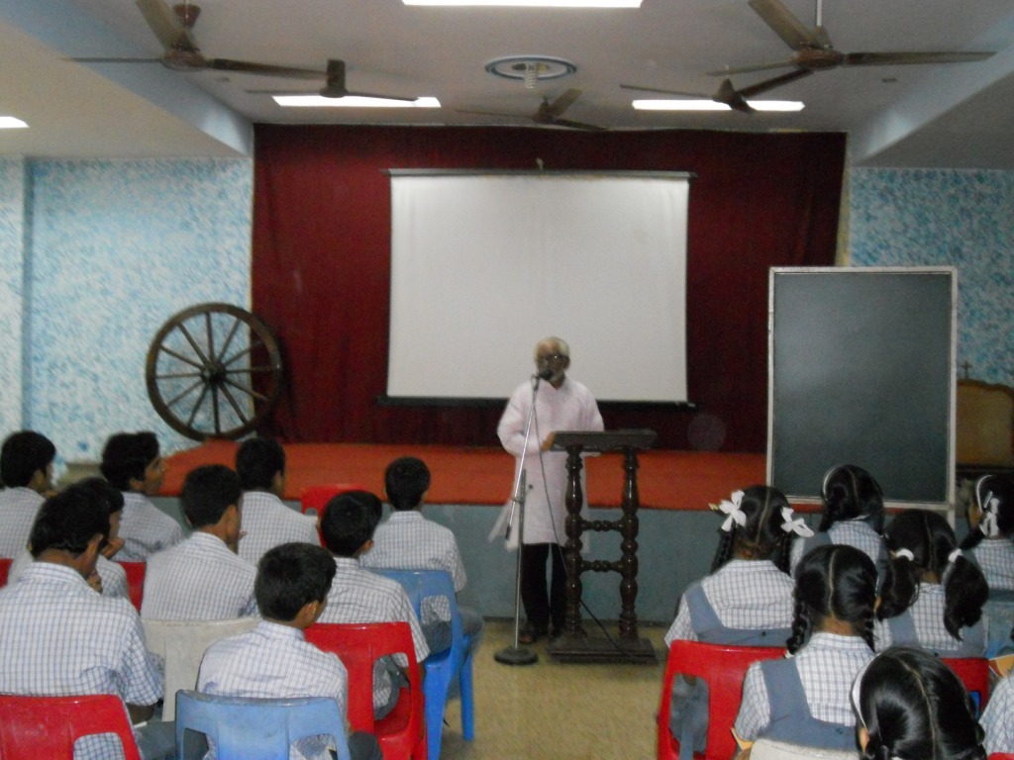
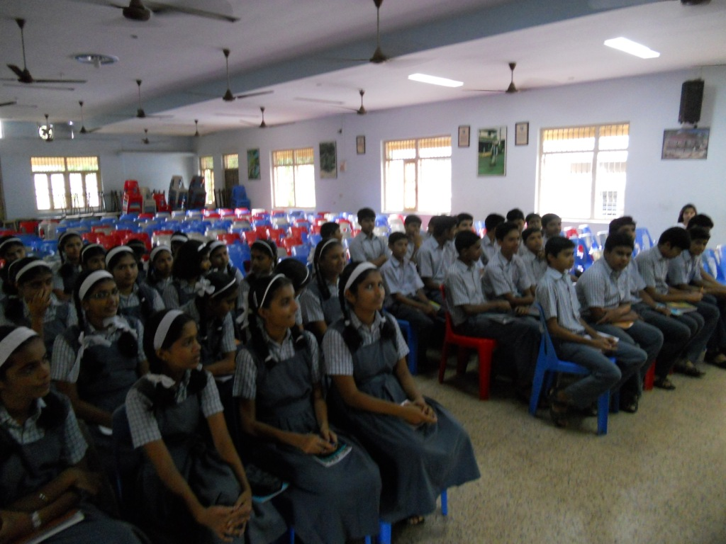
Faith
Formation

Slide 13
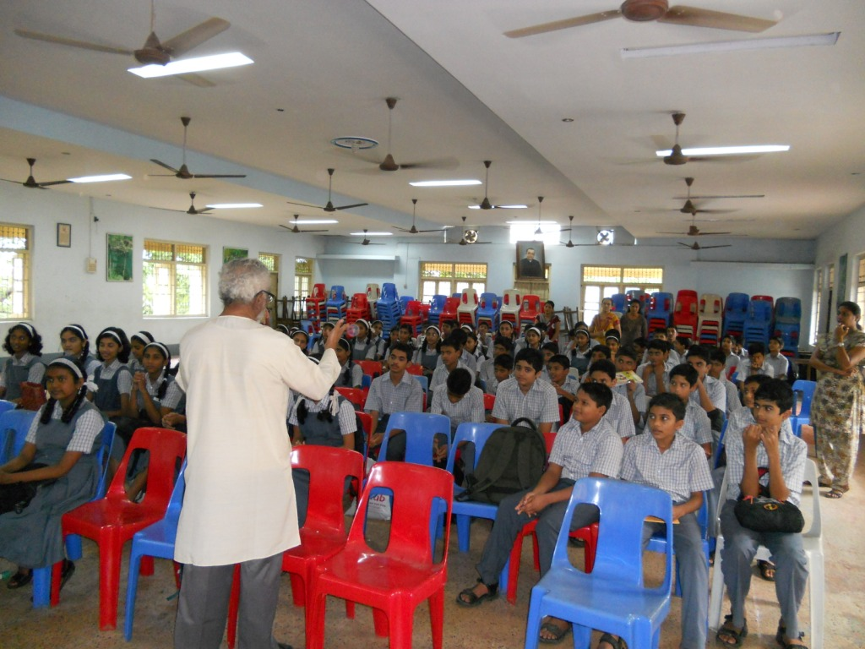
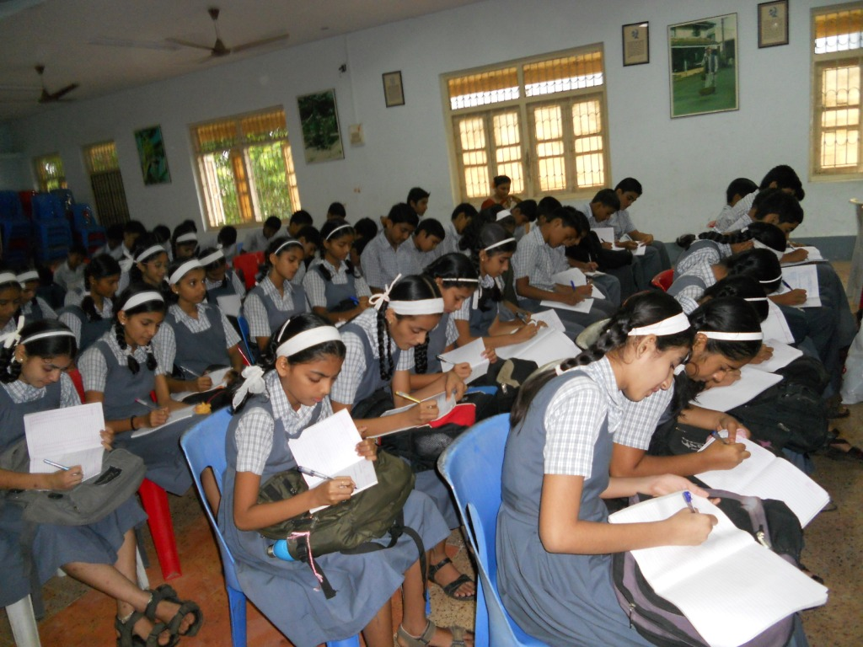
Faith
Formation

Slide 14

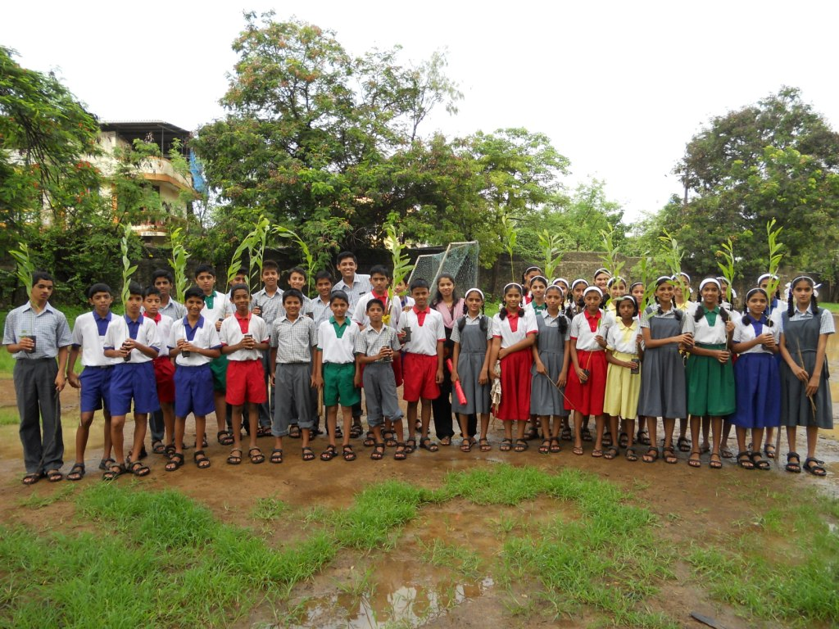
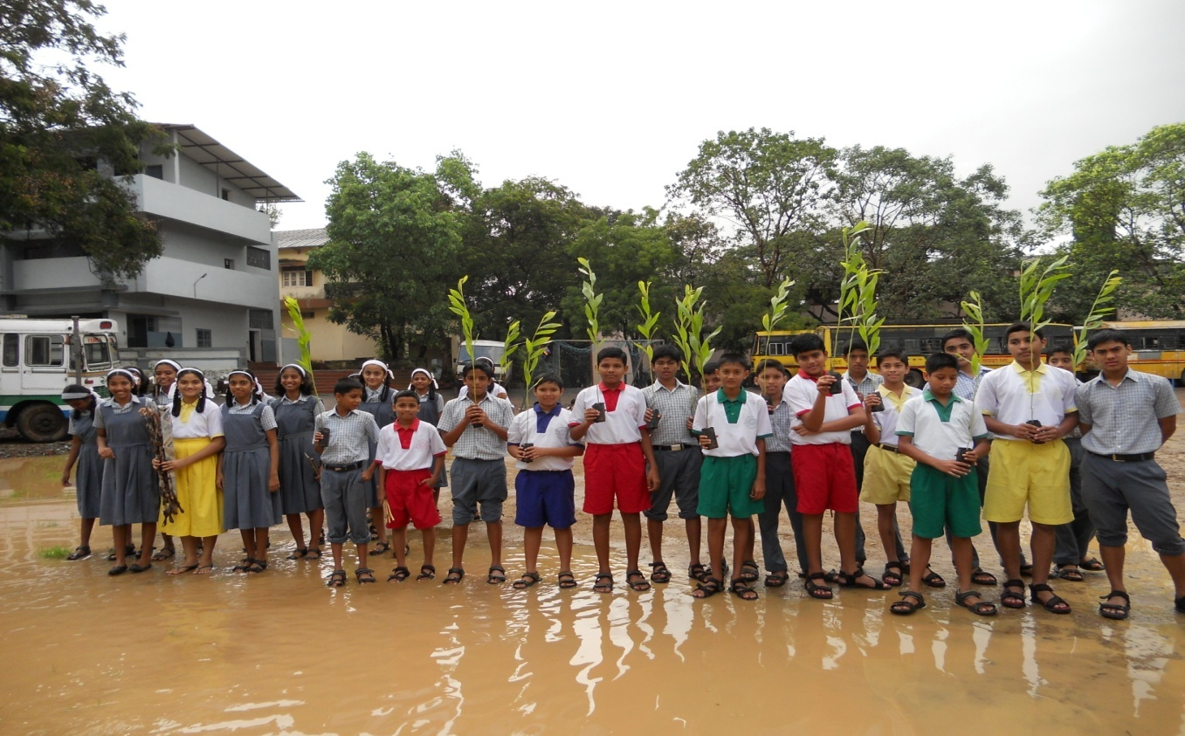
Tree
Plantation drive

Slide 15
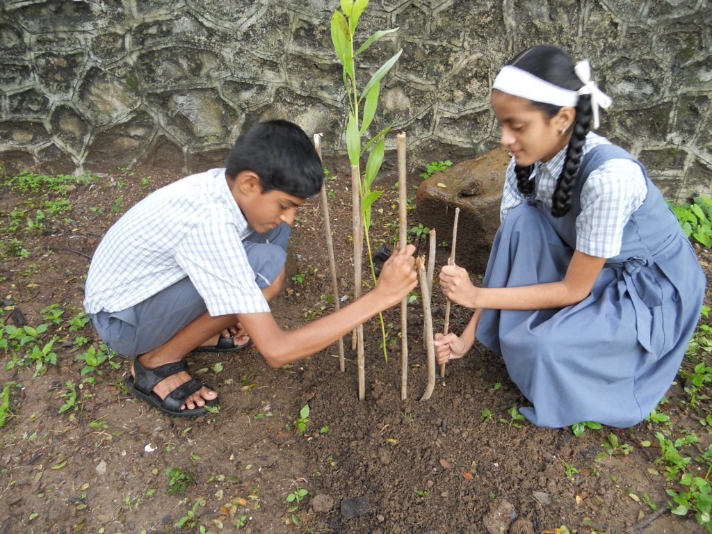
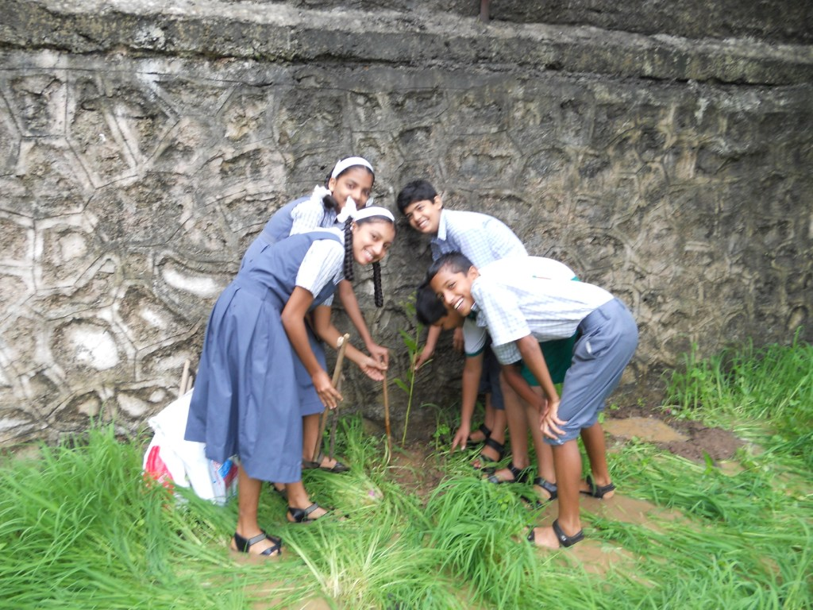
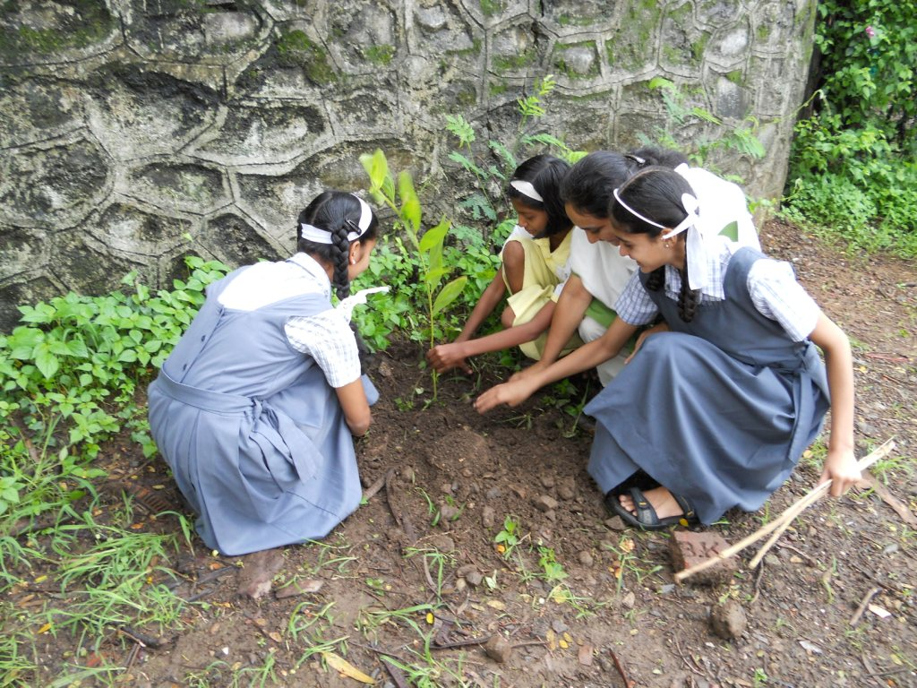
Tree
Plantation drive

Slide 16

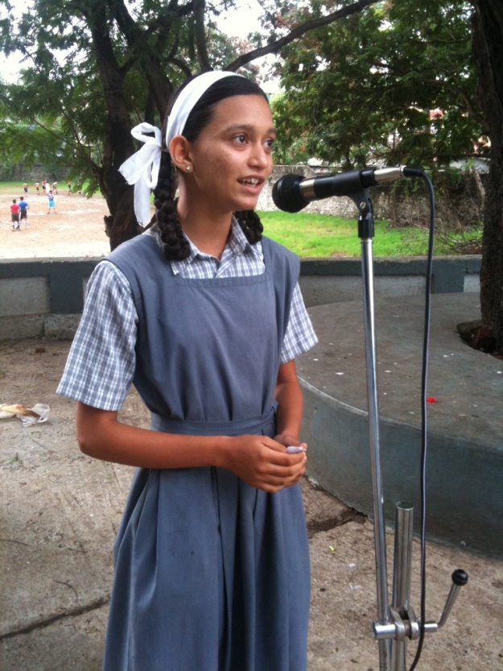
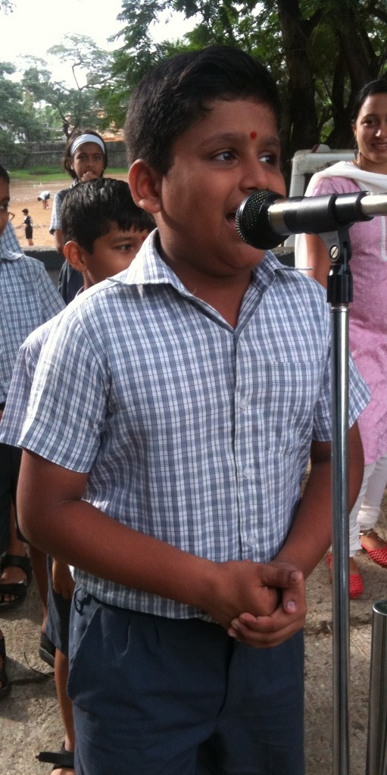
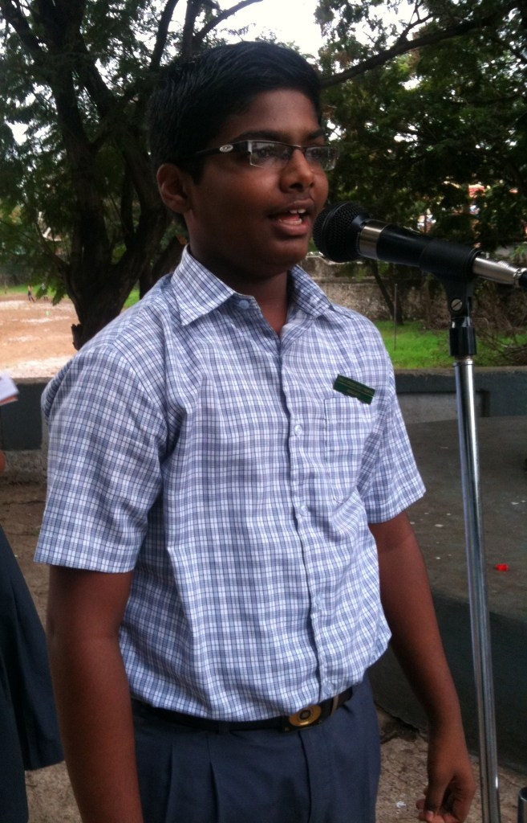
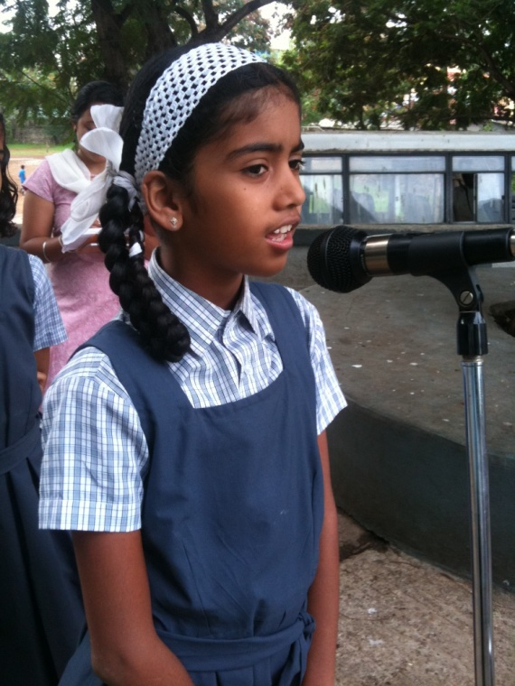
Singing
Competition

Slide 17
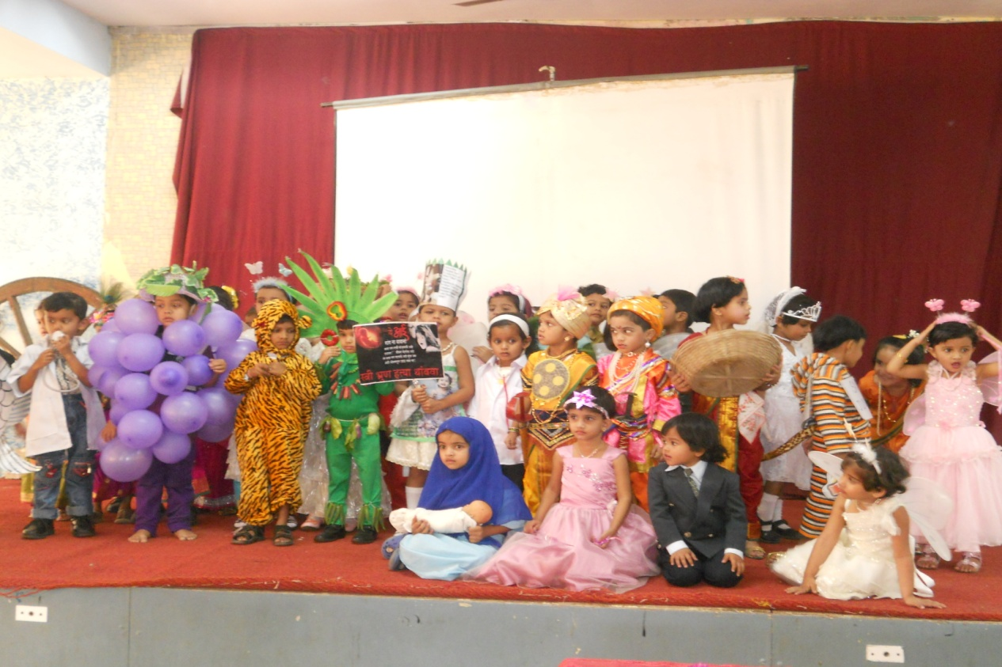
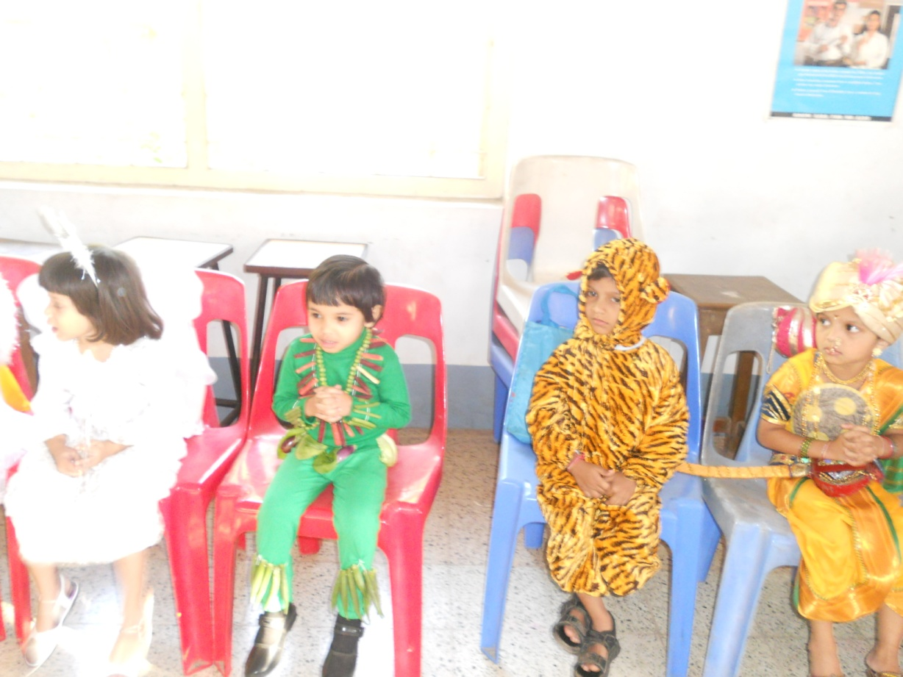
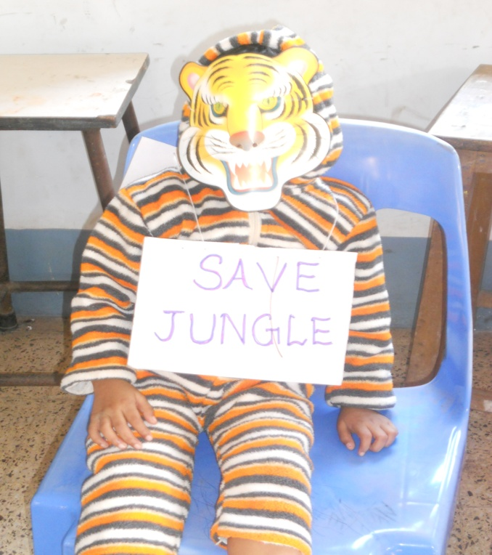
Fancy Dress
Competition

Slide 18

Winner’s of Inter-schooI Competitions

Slide 19
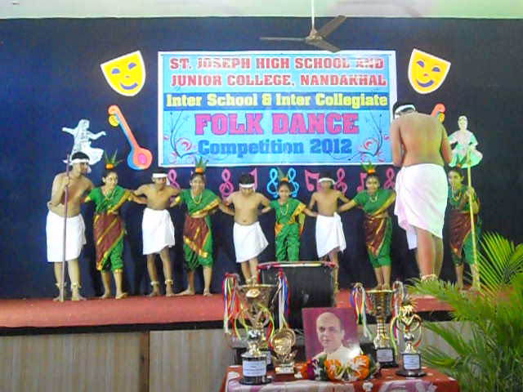
Winner’s of InterSchool Dance Competition

Slide 20

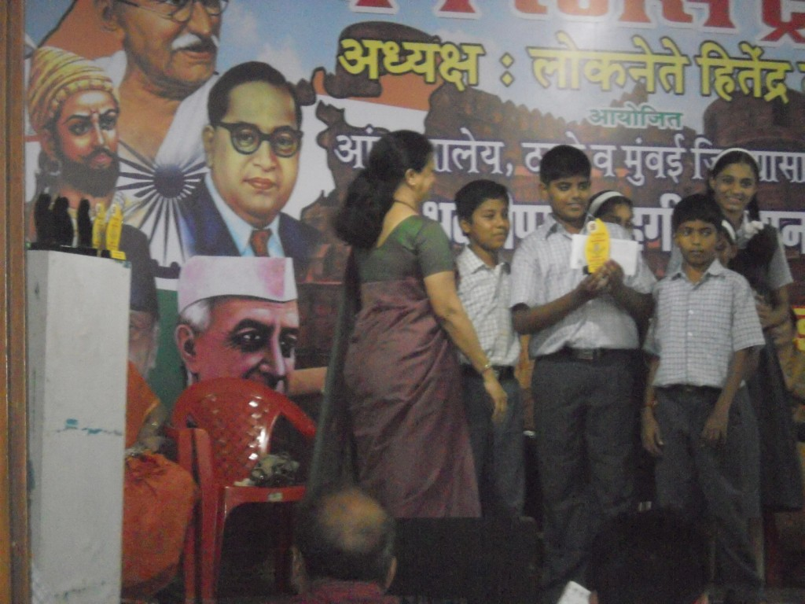
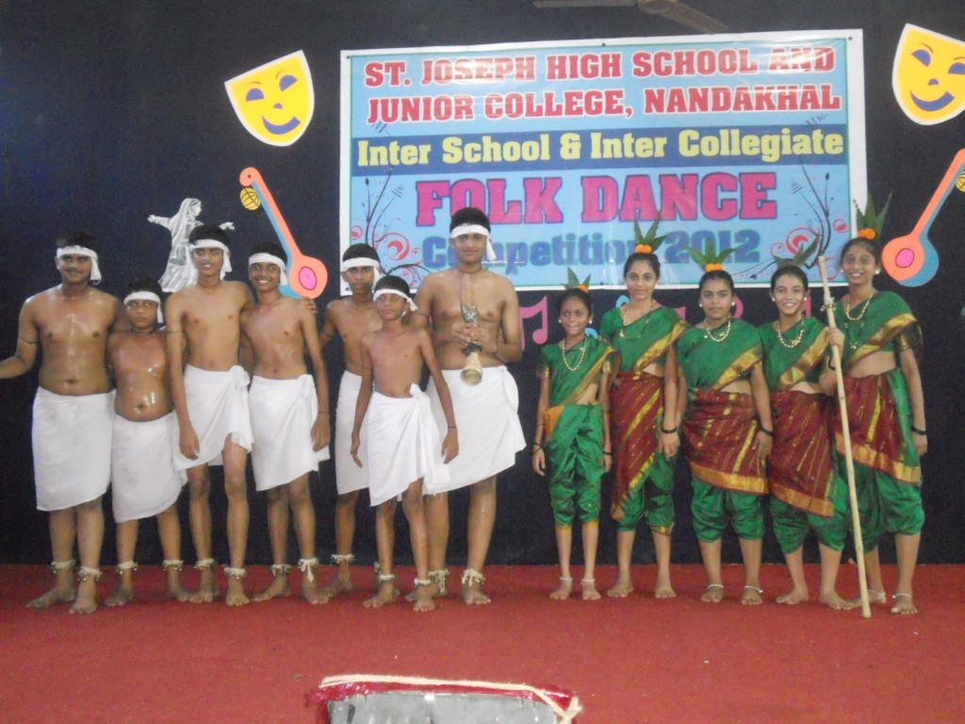
Winners of
Inter-School
Competition

Slide 21
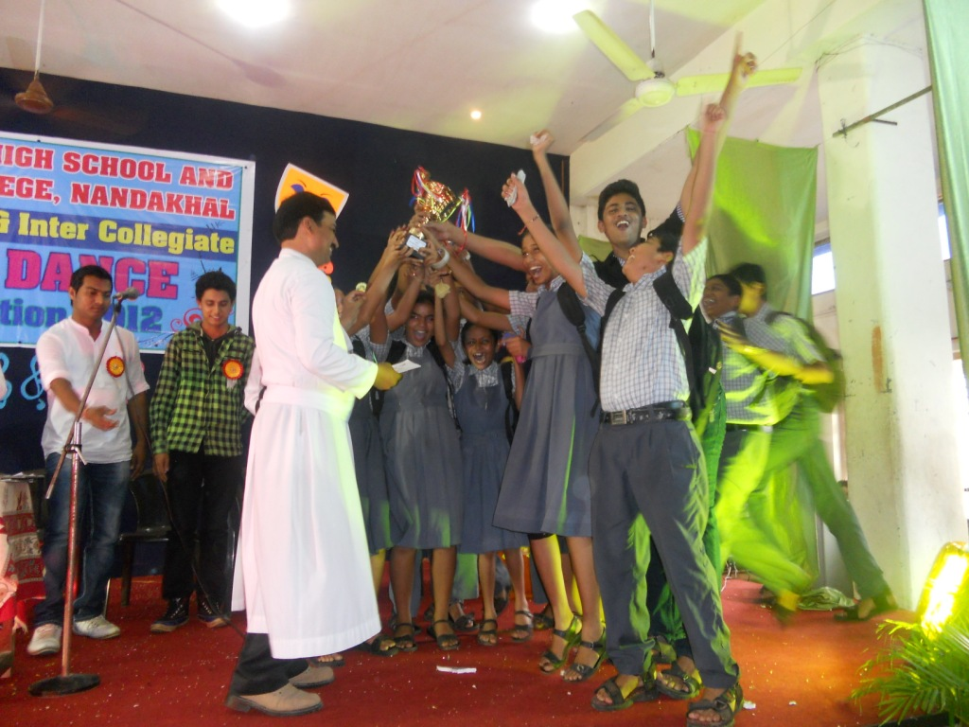
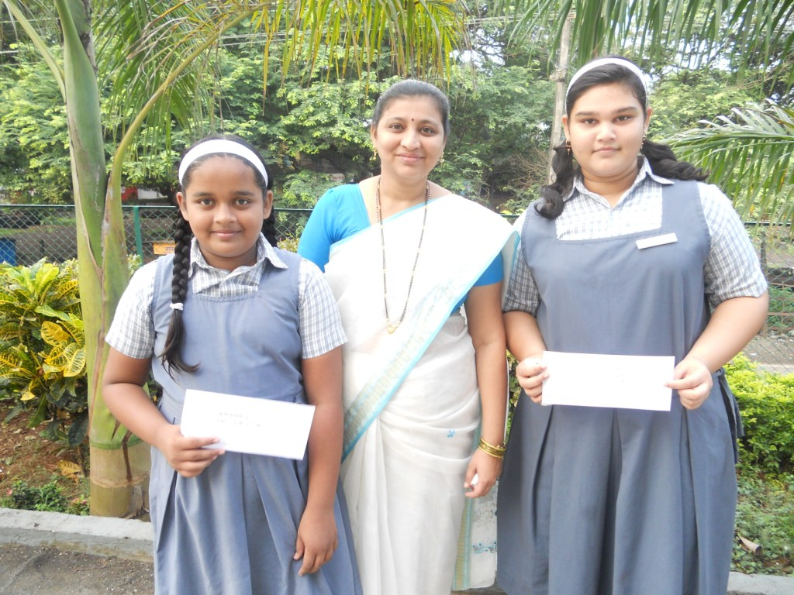
Winners of
Inter-School
Competition

Slide 22
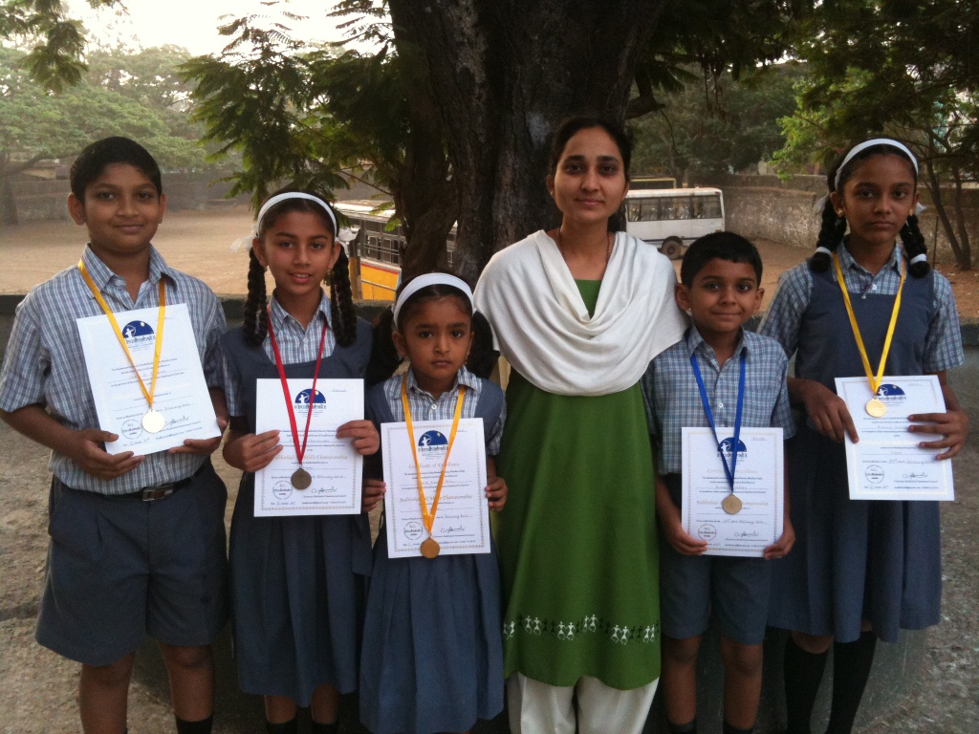
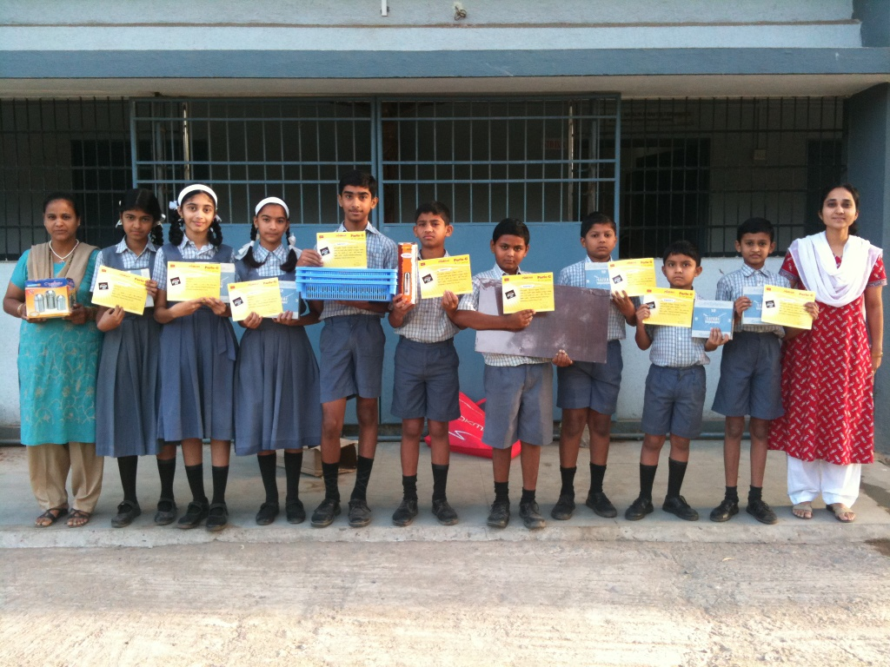
Winners of
Inter-School
Competition

Slide 23
CELEBRATIONS
In
School

Slide 24

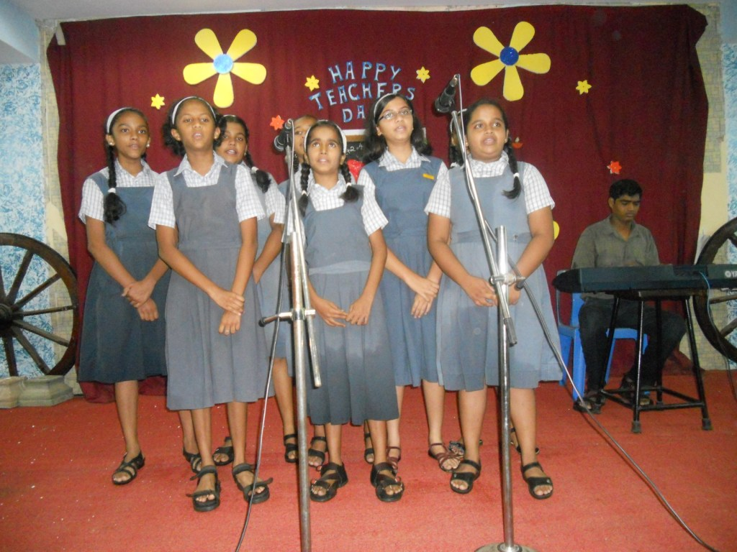
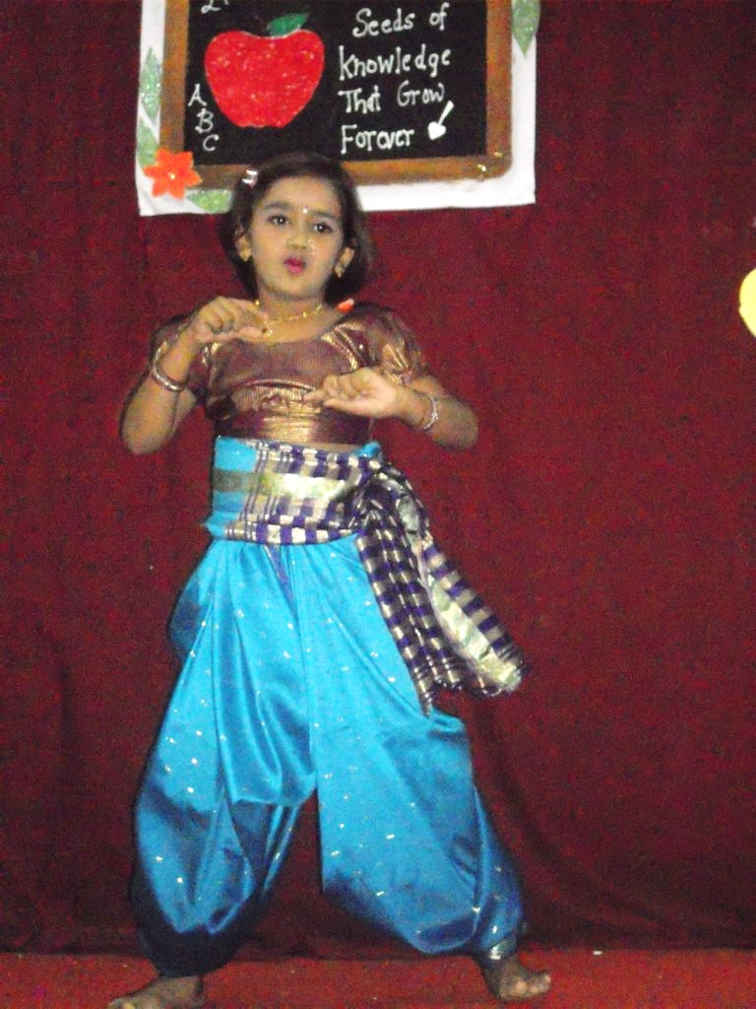
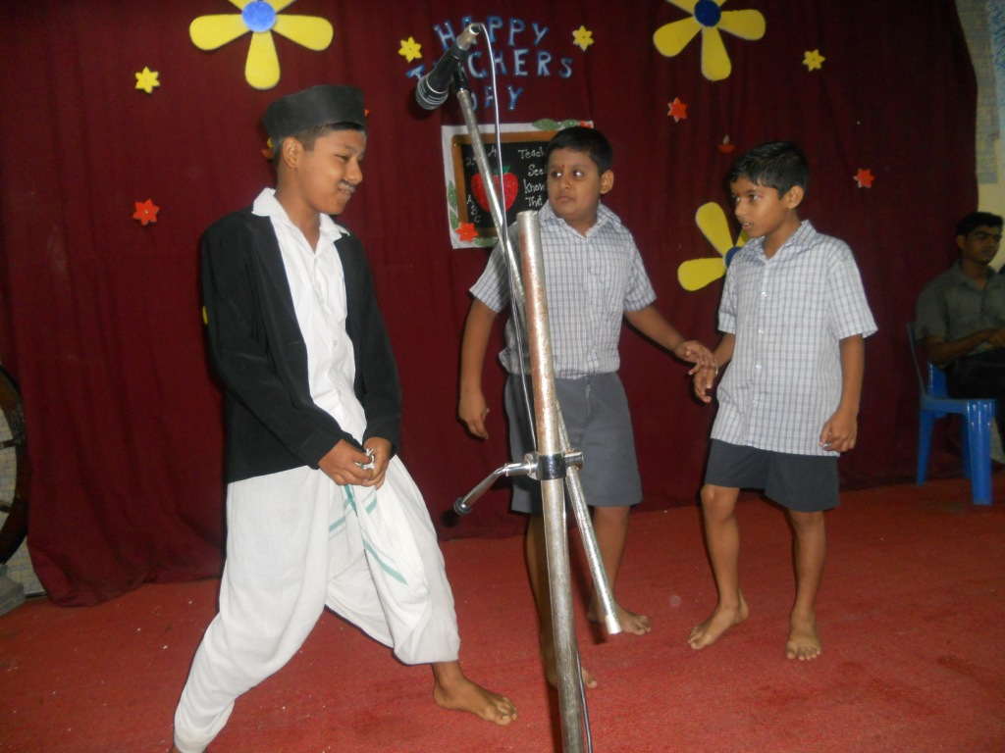
Teachers’
Day

Slide 25
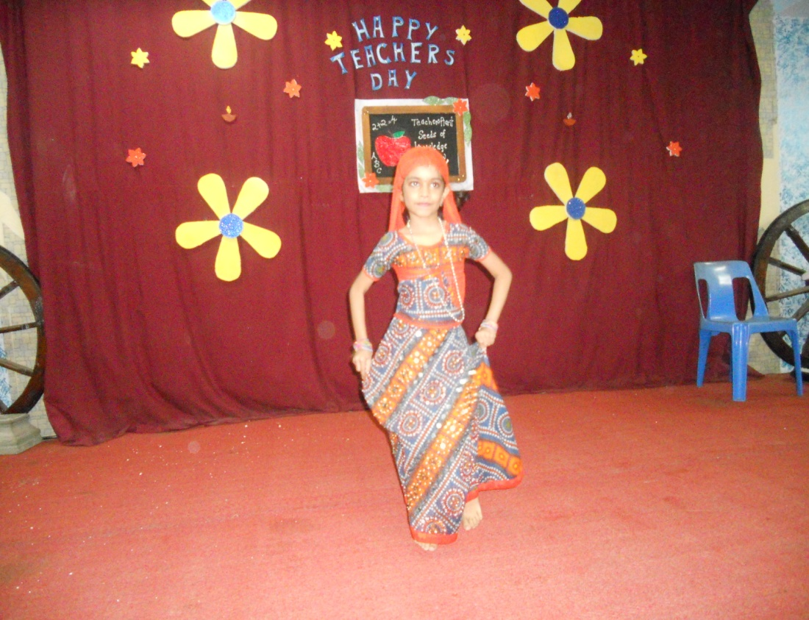
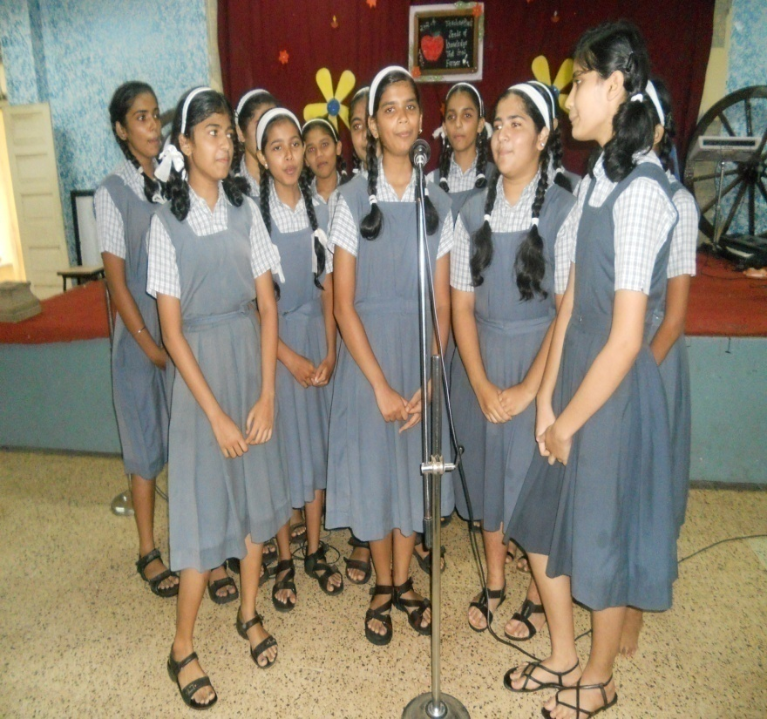
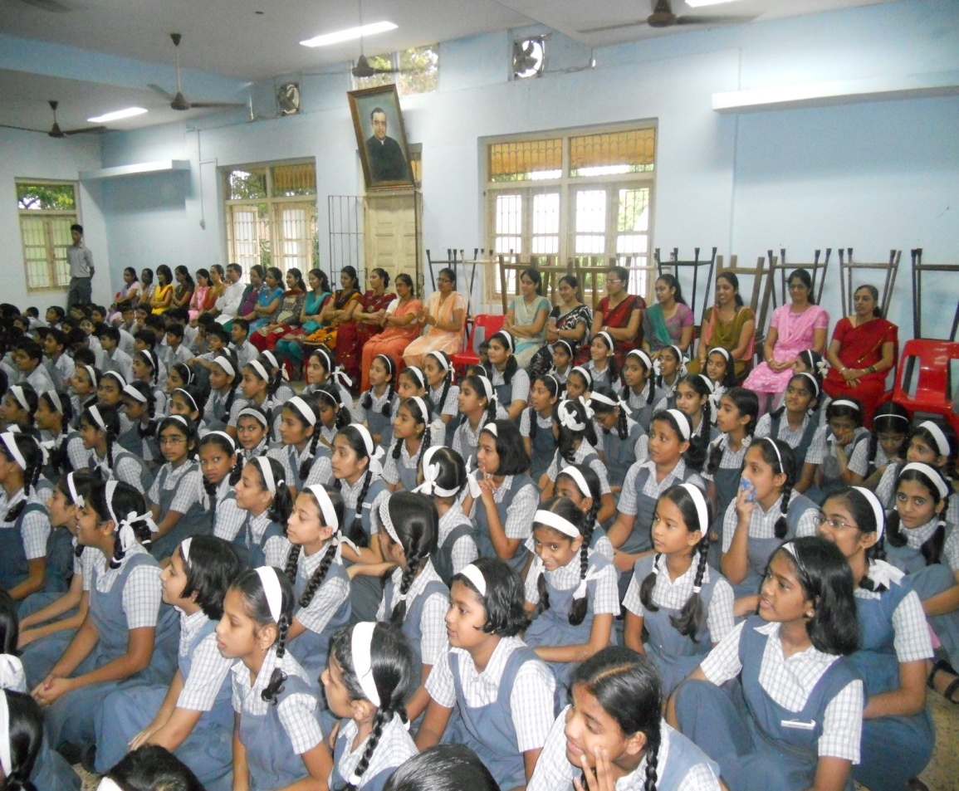
Teachers’
Day

Slide 26

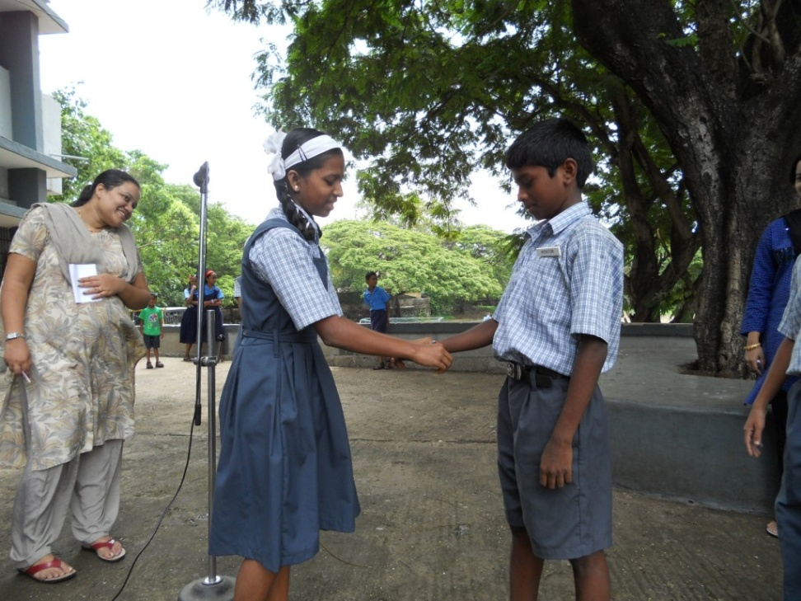
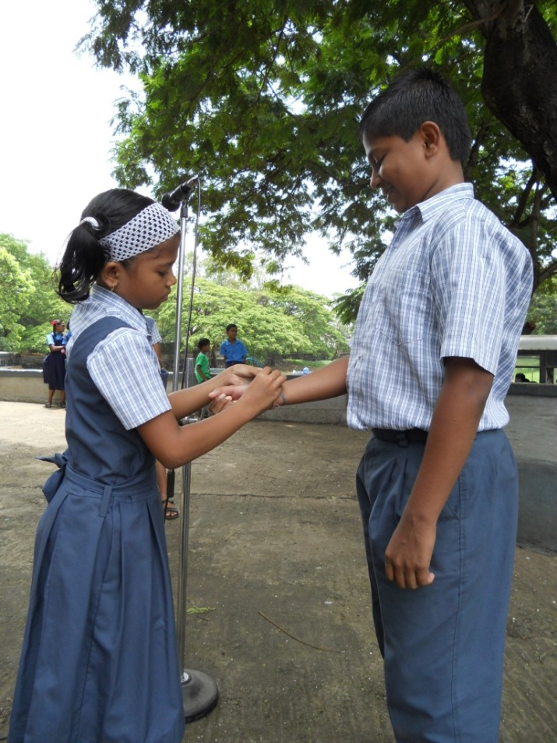
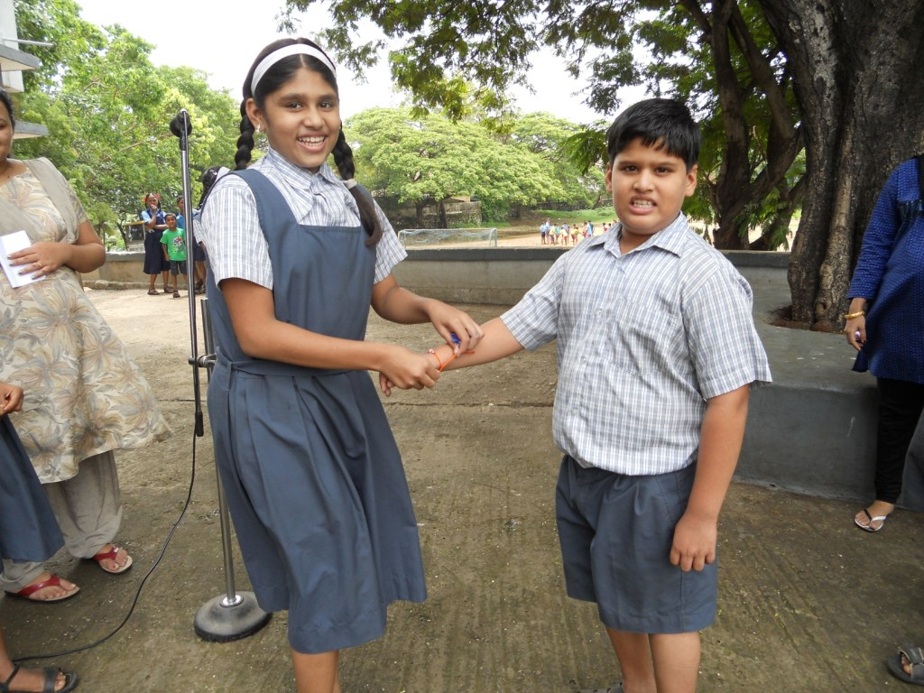
Raksha
Bandhan

Slide 27

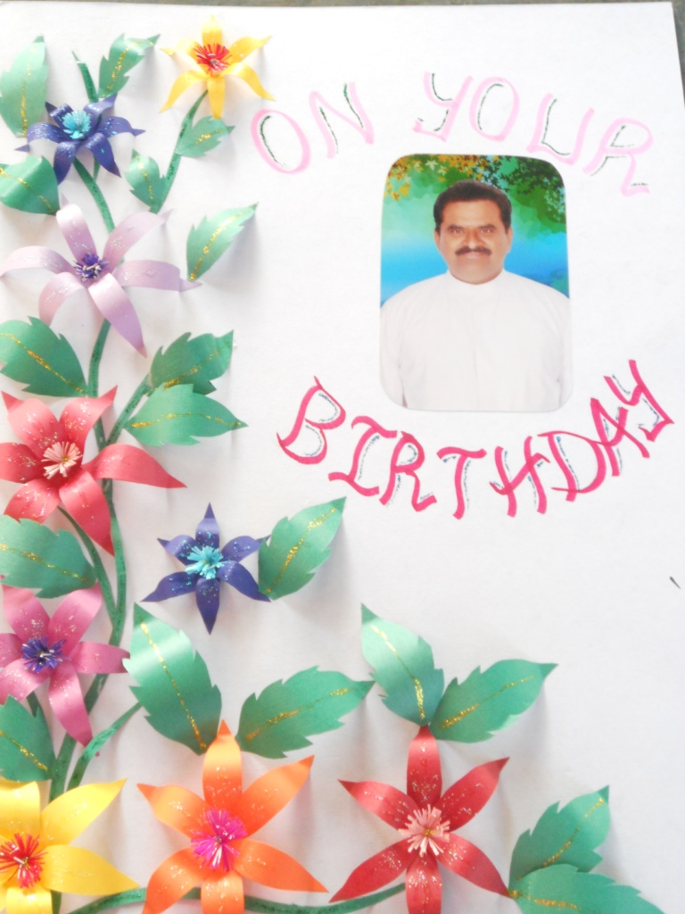
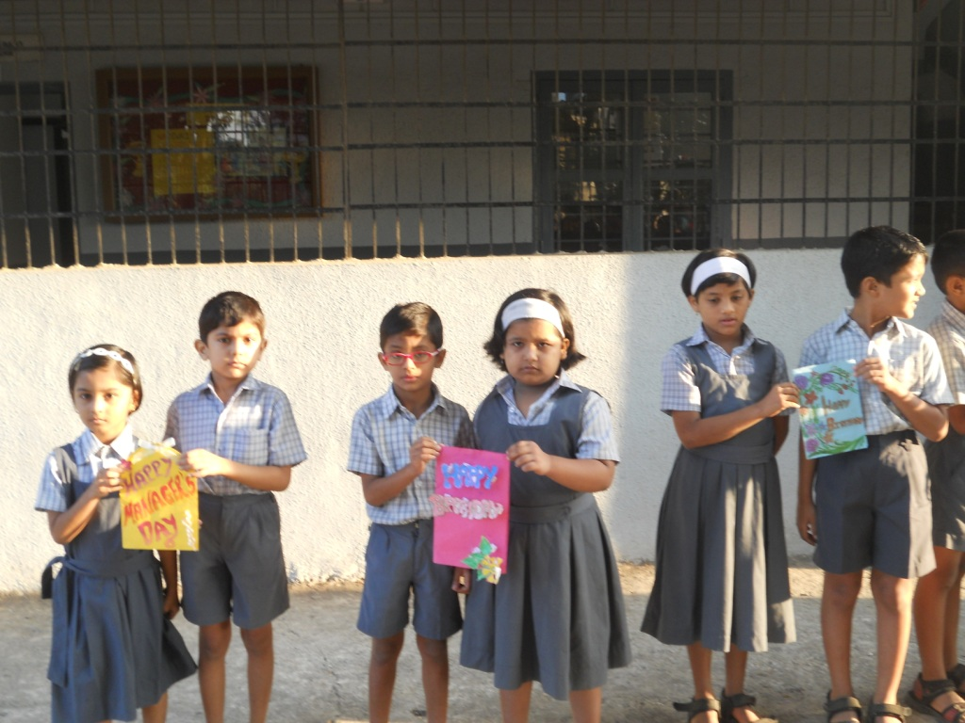
Managers’
Day

Slide 28
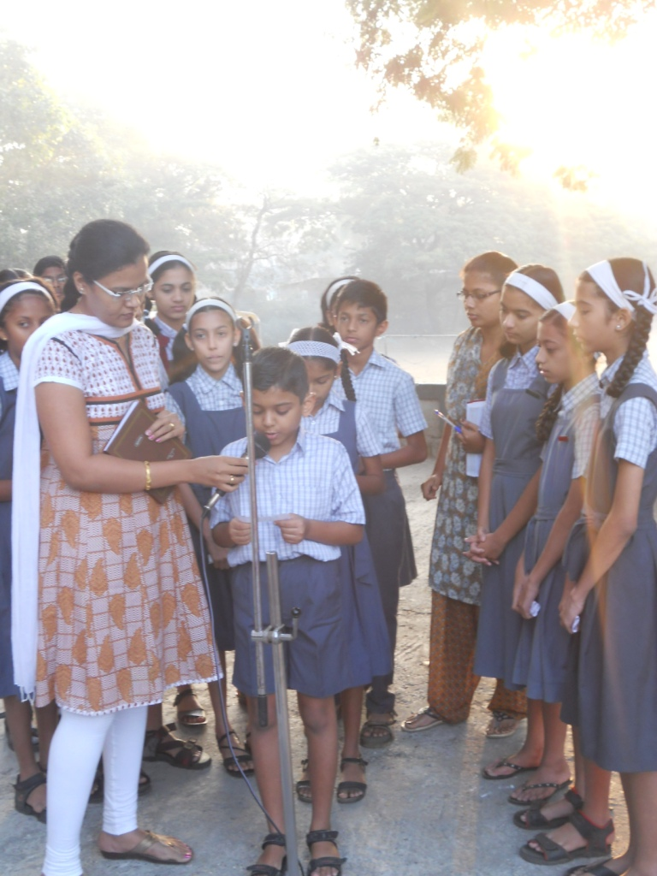
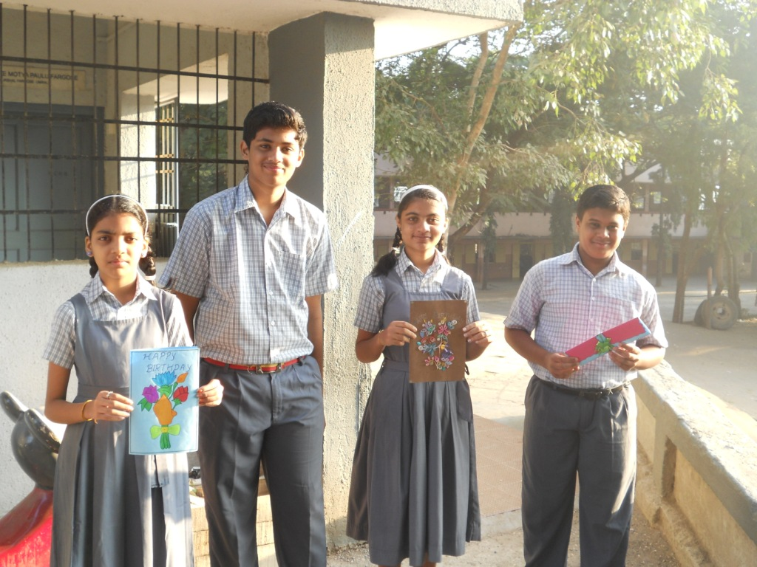
Managers’
Day

Slide 29

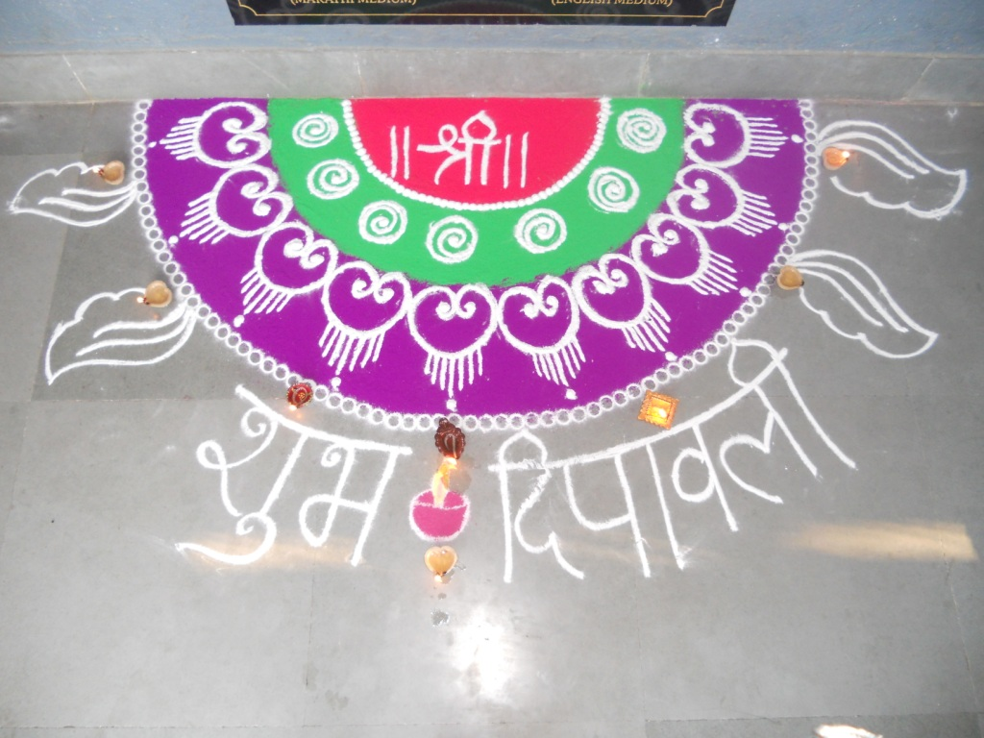


Diwali Celebration

Slide 30




Fun -Fair

Slide 31



Fun
Fair
Fun
Fair

Slide 32



Fun
Fair

Slide 33



Picnic

Slide 34



Camp to Vaeloli (Old –Age Centre)

Slide 35



(Leprosy Centre)

Slide 36



Camp to Vaeloli

Slide 37



Camp to Dapoli

Slide 38

Sports Events

Slide 39



Running
Race

Slide 40


Running
Race

Slide 41



3– legged
race

Slide 42




Book
Balancing

Slide 43



Frog
Jump

Slide 44




Spoon &
Marble
Race

Slide 45




High
Jump

Slide 46




Cricket Tournament

Slide 47




Throw ball Tournament

Slide 48




Volleyball Tournament

Slide 49




Kabbaddi Tournament

Slide 50



Pre - Primary
Sports

Slide 51



Pre – Primary
Sports

Slide 52


Band
Group

Slide 53



Band
Group

Slide 54



Karate Training

Slide 55


First SSC batch

Slide 56




Felicitation of SSC Toppers

Slide 57


Slide 58


